Slide 1
Cooking with AWS and Splunk
Module 4 : Setup Splunk App for AWS
Kam Amir | Splunk Cloud Architect

Slide 2
Setup AWS Account / Inputs Overview
Credentials
Add user credentials (Access Key / Secret Key) to Splunk for AWS authentication [Optional if no access to machine – Splunk Cloud Sales Trial]
Attach EC2 Role to EC2 instance [Preferred Authentication – Marketplace AMI]
AssumeRole Process for Sub-account Data Collection
AWS Data Collection Best Practices
AWS Config, Config Rules, CloudTrail, Inspector, Description, Kinesis, CloudWatch Inputs
Billing Cost and Usage Report (CUR)
S3
Configure AWS Inputs in Splunk
SNS Alerts
Create an SNS Alert in Splunk
High Volume Data Collection
VPCFlowLogs (Lambda -> HEC)
VPCFlowLogs (S3 -> SQS Based S3)

Slide 3
Manually Add AWS Account vs. EC2 Role
When to manually add AWS credentials vs. using EC2 Role
Add AWS Account
Splunk Cloud Sales Trial
Manually Add AWS Account
Splunk Enterprise AMI
Add EC2 Role
Notes:
There are a couple ways to enable your AWS account to the Splunk Add-on for AWS. The first path is if you are using the Splunk Cloud Sales trial or any system where you do not have access to the AWS AMI running the Add-on. You will need to manually add your account using the Access_Key and Secret_Key found in your credentials.csv file. The second path allows you to attach the AWS Policy directly on the machine where the Add-on will auto-discover the policy and account without having to use any keys.

Slide 4
Credentials
Using Access Key Credentials

Slide 5
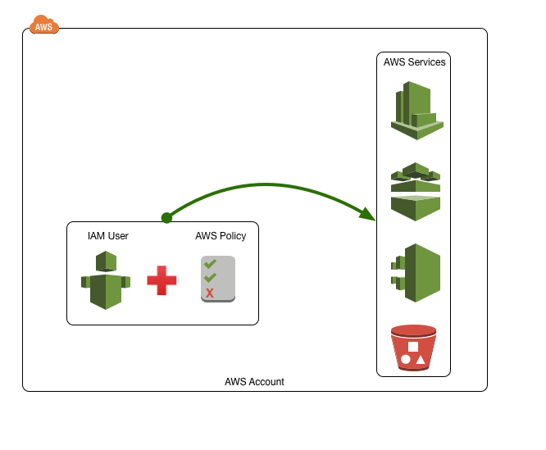
Connect Directly with IAM User
Smaller organizations leverage Users with Policy’s to access Services
Small AWS deployment and no restraints on IAM user access
Used for testing purposes
Single User connecting to AWS Deployment
No access to Splunk Deployment (Splunk Cloud, Splunk Cloud Sales Trial)
Notes:
When you use the Splunk Cloud Sales trial instance, the only way you can add your credentials will be using an IAM user account with an Access and Secret key.

Slide 6
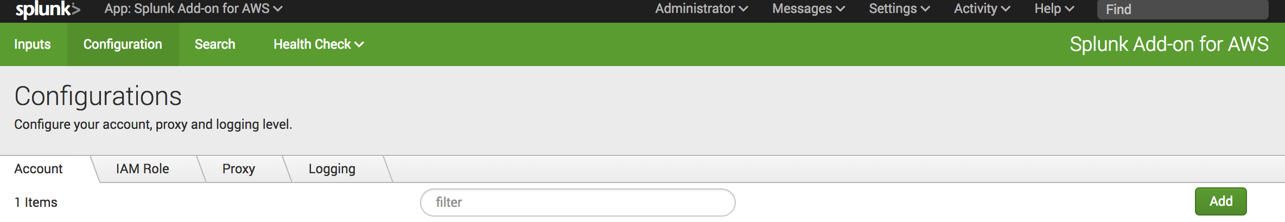
Add SplunkAccess Account
Open Splunk Add-on for AWS -> Configuration ->Create an account -> Add
Click Here
Click Here
Notes:
Once you have navigated to the Add-on for AWS and clicked on Configuration-> Create an account, and click Add.

Slide 7
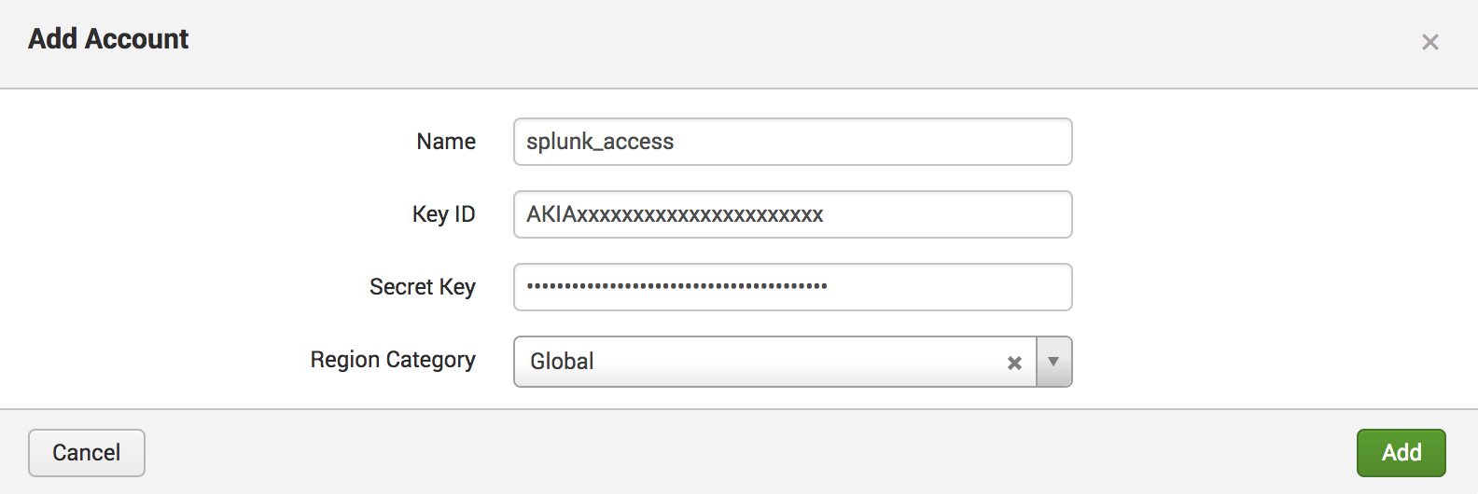
Add splunk_access Account
Enter Key ID and Secret Key from credentials.csv
Notes:
Input your account name along with the Access and Secret Key. Leave the region at Global unless you are using GovCloud or AWS China. The keys can be found in your credentials.csv file. Click Add and you should see the account show up in the account list.

Slide 8
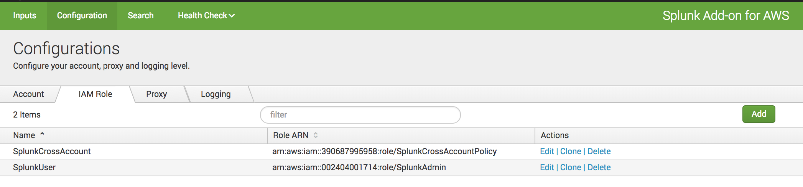
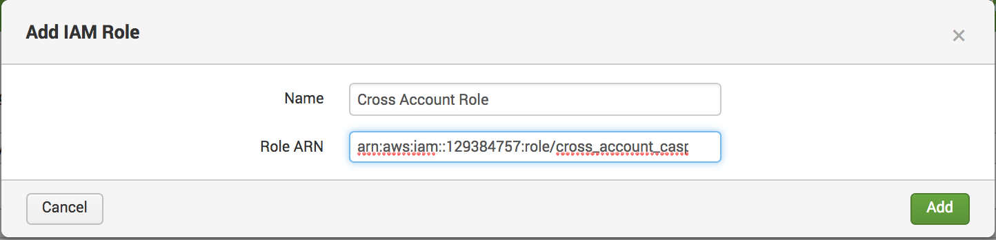
Sub-Account Data Collection
This role will be able to AssumeRole to a role in a sub-account with SplunkAccess
Notes:
Once this role is created, go to Splunk Add-on for AWS -> Configurations -> IAM Role and click Add. Then, take the role ARN and set it up in the Splunk Add-on for AWS as an IAM role. Use the AssumeRole field in any of the inputs to gain access to the sub-account AWS services.

Slide 9
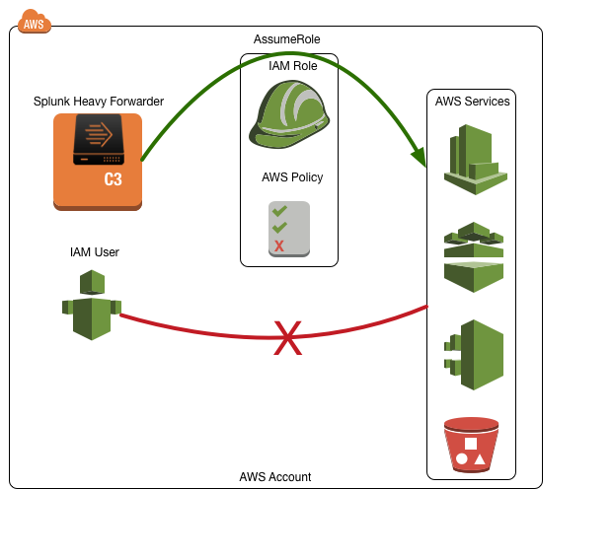
AssumeRole with EC2 Instance
Organizations with tight security controls and do not give out access keys
No direct access for IAM users or disabled AssumeRole for IAM Users
Credentials managed by assigning them to instances via IAM AssumeRole to instance
Very restrictive environment
HWF Resides in corporate VPC and can attach roles (AWS Market Place, AMI, CloudFormation Template)
Notes:
This solution is used when you do not want to leverage your credentials from your users but rather attach the policy directly to the EC2 instance. Customers with direct access to the AWS AMI will probably use this method for authentication.

Slide 10
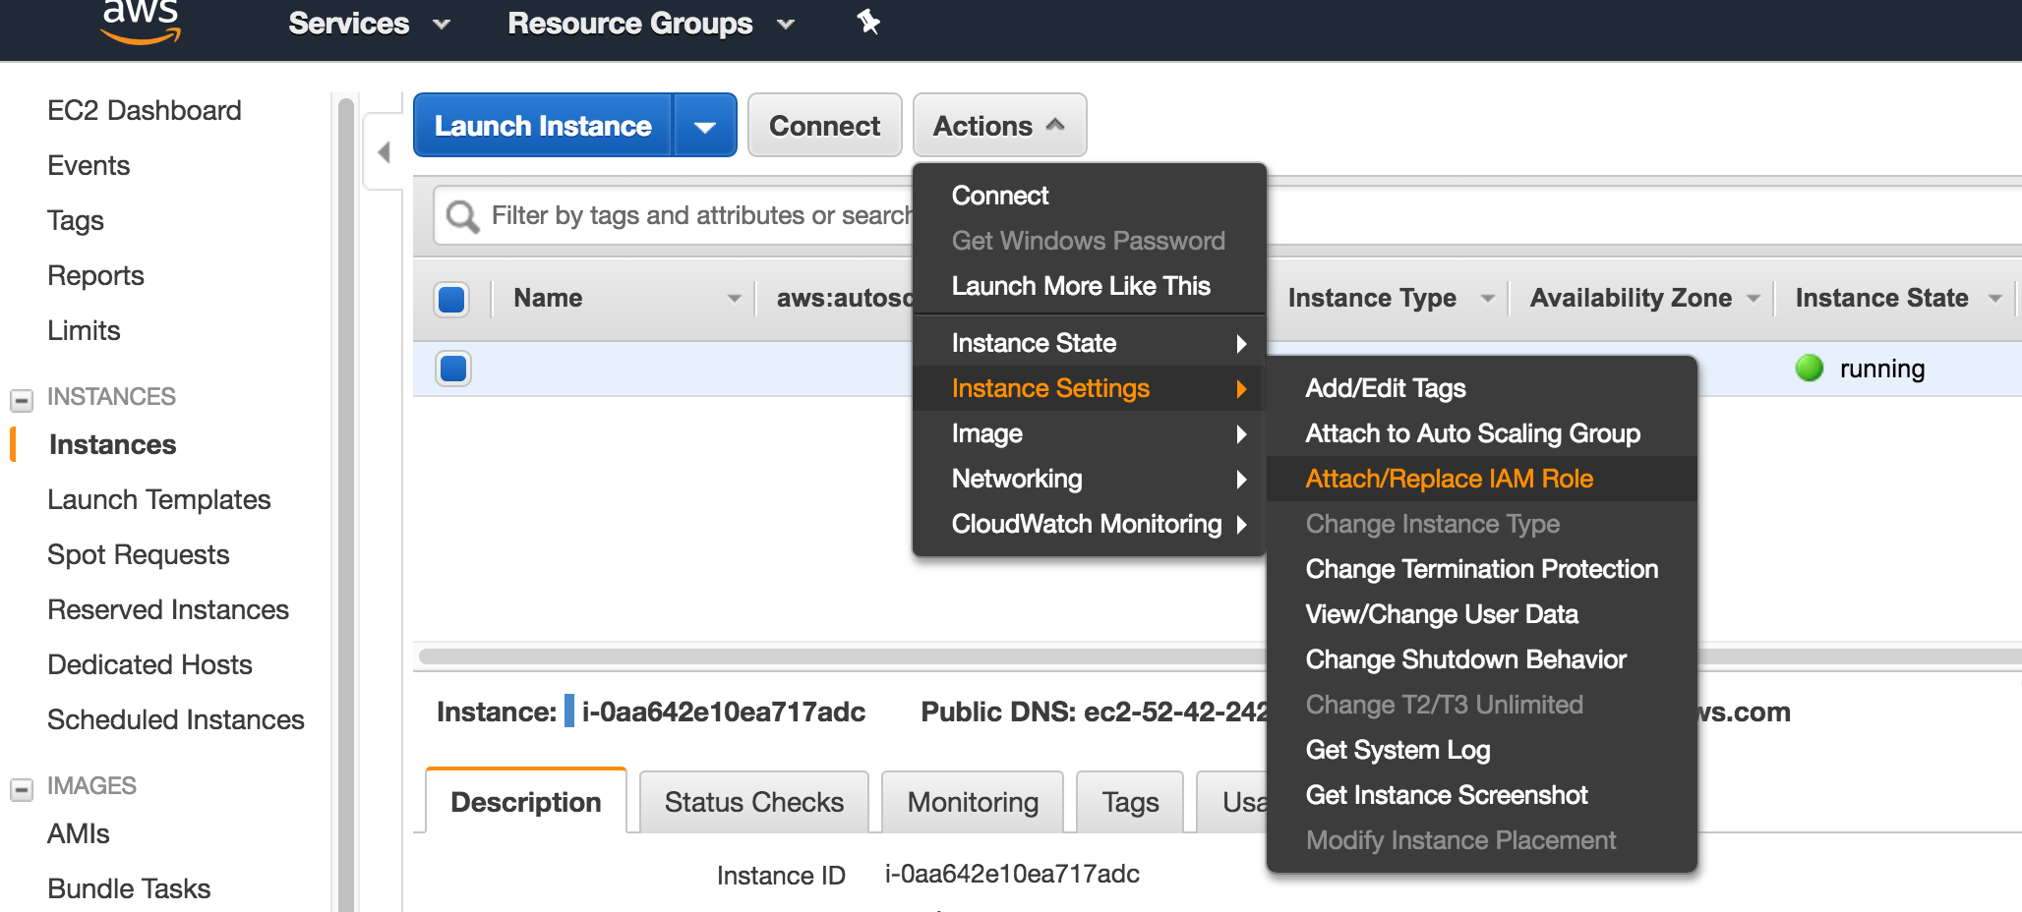
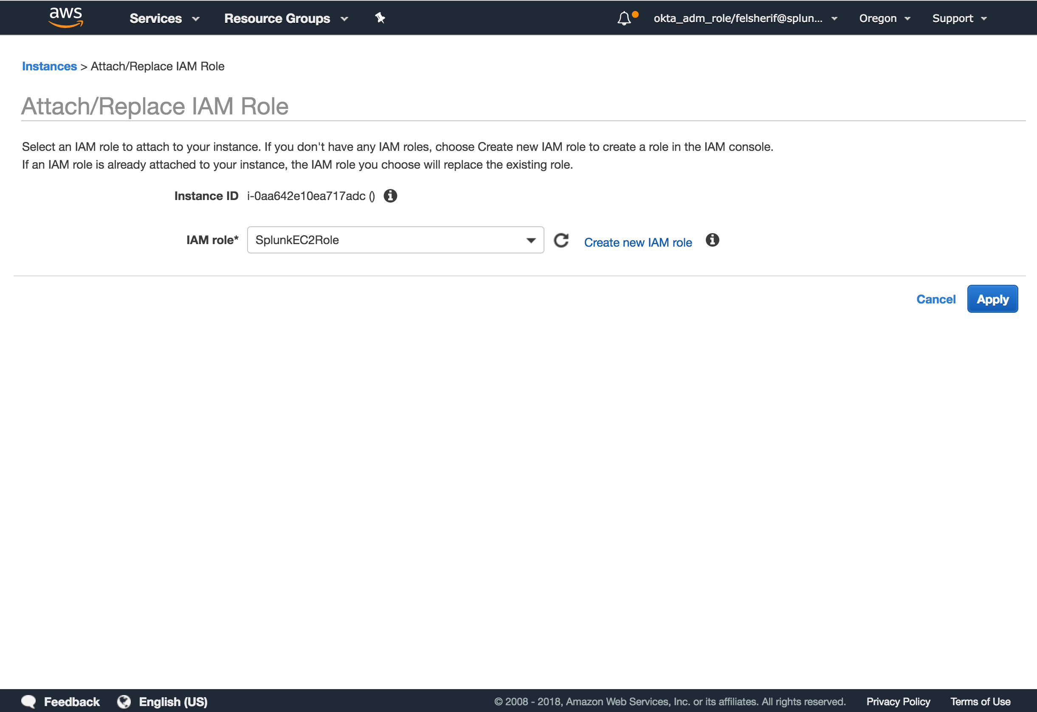
Attach Policy to an Existing EC2 Instance
EC2 Instance AssumeRole will auto-discover account information
AWS Home
EC2 Instances
Select EC2 Instance
Actions
Instance Settings
Attach/Replace IAM Role
Select Existing Policy
Apply
Select an existing policy or create a new one with special permissions.
Notes:
In your AWS console, navigate to the EC2 Dashboard then select instances. Click the box next to your instance running the Splunk Add-on for AWS and then click the Actions drop down and go to “Attach/Replace IAM Role.” Here, select the Splunk EC2 role you created earlier and attach it to this instance. The Add-on for AWS will auto-discover this role and grant access to the aws services.

Slide 11
AWS Data Collection Best Practices
When to use Heavy Forwarders, HEC to collect Data from AWS into Splunk

Slide 12

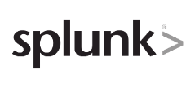
End State: Comprehensive AWS Visibility
Notes:
Splunk provides comprehensive visibility for your AWS environment, allowing you to easily search, analyze, correlate, visualize, and act on your data.

Slide 13
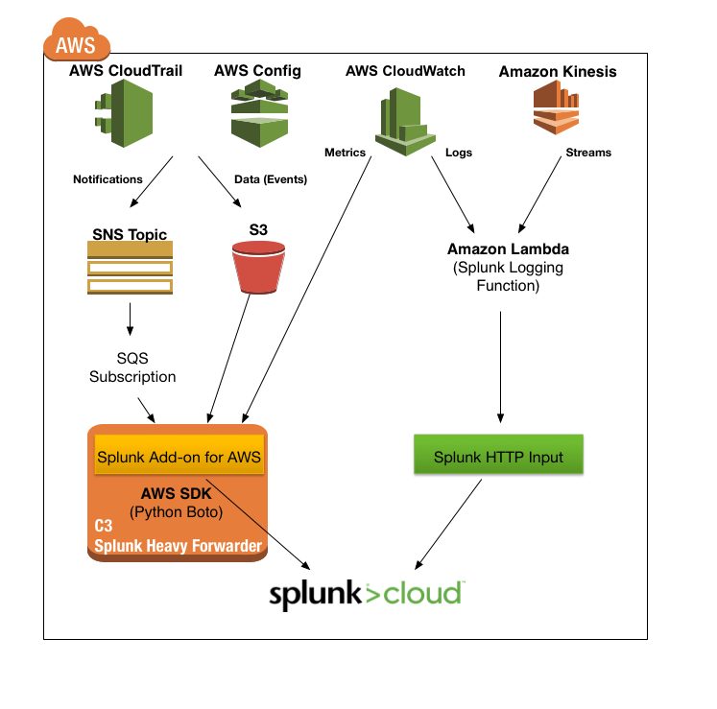
Use HWF to collect AWS Data
Best Practices for Collecting Data from AWS into Splunk
Collect AWS data using a Splunk Heavy Forwarder for SQS Based S3 and other modular inputs (Billing, Inspector, Config Rules, Description etc.)
Collect high volume data using Lambda Function to Splunk HTTP Event Collector (HEC)
Kinesis Firehose (Module 9) can collect data in real-time with a built in buffer plus a “splash back” to an S3 bucket.
Notes:
Using a Splunk Heavy Forwarder to collect the AWS data is the preferred way to collect the data from AWS. The data coming from AWS requires modular inputs to connect to the AWS API’s and then a pull mechanism to collect the data. Some data sources, like AWS VPC Flow Logs or other high volume sources, should be collected using more performant inputs like Lambda to HEC or Kinesis Firehose.

Slide 14
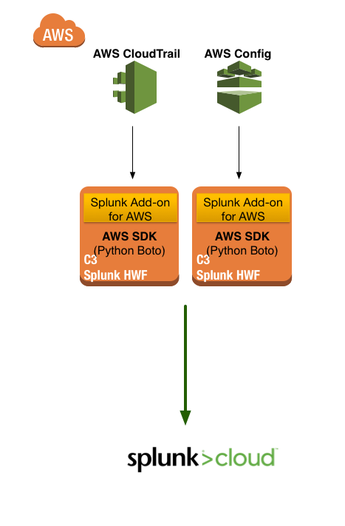
SQS Based S3 vs. Legacy Modular Input
SQS Based S3 input is a more scalable approach to collect AWS Data
Architecture
Legacy Based Modular Input
Legacy Modular Input does not have fault tolerance. If one HWF goes down, then it can no longer collect the data and send it to get indexed
Each HWF must maintain state, which means that upon failure you will have to move the input to another working node
The data collection cannot be load balanced across tiers
Notes:
The legacy inputs for AWS Config and AWS CloudTrail leverage one modular input for each service. While this allows for the collection of the data, it introduces a single point of failure which can stop collecting data if the HWF goes down.

Slide 15
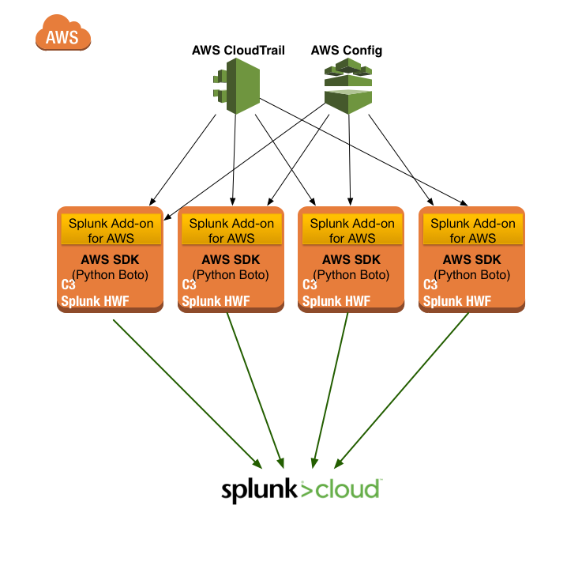
SQS Based S3 vs. Legacy Modular Input
SQS Based S3 input is a more scalable approach to collect AWS Data
Architecture
SQS Based S3
Fault tolerant data collection. If one node fails, another node will collect the data.
Each HWF is stateless and will not impact the data collection from any other node.
Data collection can be load balanced across multiple heavy forwarder nodes.
Notes:
The new SQS Based S3 input method allows for data collection to be scaled across multiple heavy forwarders. This is possible since the inputs are stateless, unlike the legacy inputs, which allows for multiple inputs to be placed across a hwf collection tier. The SQS Based S3 input leverages the dead letter queue from the AWS SQS service to keep the state of the events.

Slide 16
Splunk Supported AWS Services
Name | Brief Description | Input Type | Notes
CloudTrail | API activity audit trail | Modular Input (SQS Based S3) | Moderate Volume/High Value
Config | Change management data | Modular Input (SQS Based S3) | Low Volume/High Value
Config Rules | Configuration rule check/evaluation | Modular Input | Low Volume/High Value
CloudWatch Metrics | System/Service metrics data | Modular Input | Low Volume / Moderate Value
CloudWatch Logs | Service or application logs | HEC | High Volume / Moderate Value
VPC Flow Logs | VPC/“Firewall” logs | HEC | High Volume / Moderate Value
Detailed Billing | Spending information for each service and account | Modular Input | Moderate Volume / High Value
ELB | Elastic Load balancer logs | Modular Input – Low Volume HEC – High Volume | High Volume / Low-Moderate Value
CloudFront | Content delivery network access logs | Modular Input | High Volume / Low-Moderate Value
S3 | S3 bucket access logs | Modular Input | High Volume
S3 (ANY) | Any service or application that logs into S3 | Modular Input | High Volume
Lambda | Event driven computation framework | Modular Input | High Volume
Inspector | Security scan/assessment | Modular Input | Low Volume/High Value
Kinesis Streams | Generic streaming data | Modular Input – Low Volume HEC – High Volume | High Volume
SQS | Simple queuing service | Modular Input (SQS Based S3) | High Volume
Metadata | Custom Splunk-side collector of metadata about AWS environment | Modular Input | High Volume
Notes:
Here is a list of the supported inputs for the Splunk App for AWS and Add-on.

Slide 17
Configure AWS Inputs in Splunk
http://docs.splunk.com/Documentation/AddOns/released/AWS/Configureinputs

Slide 18
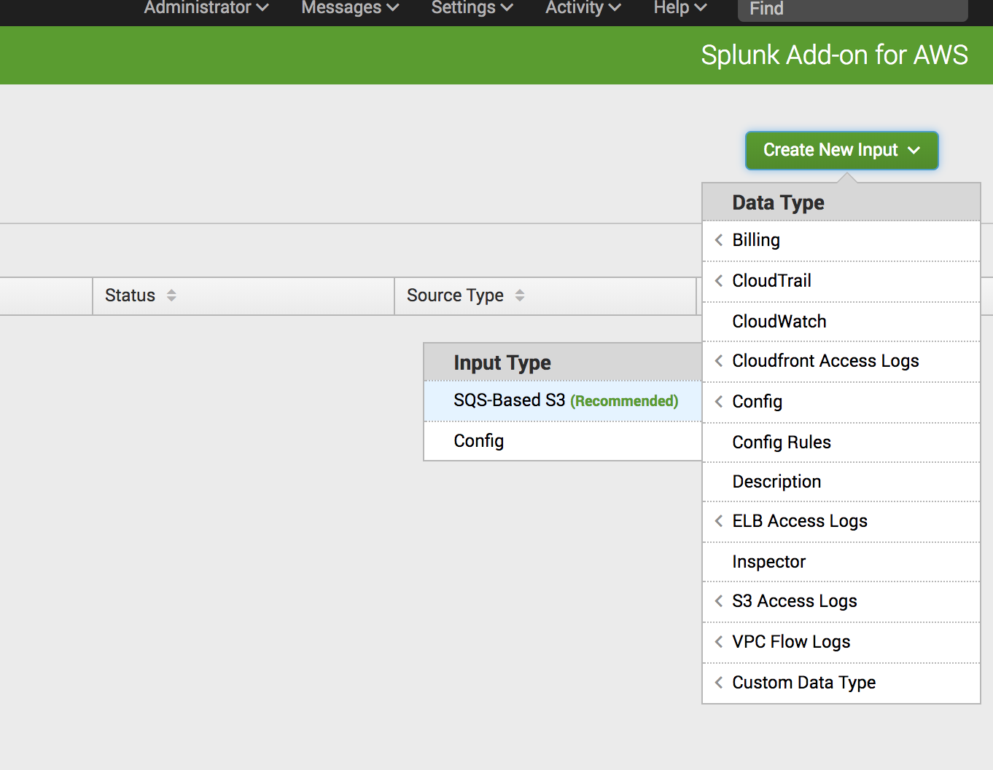
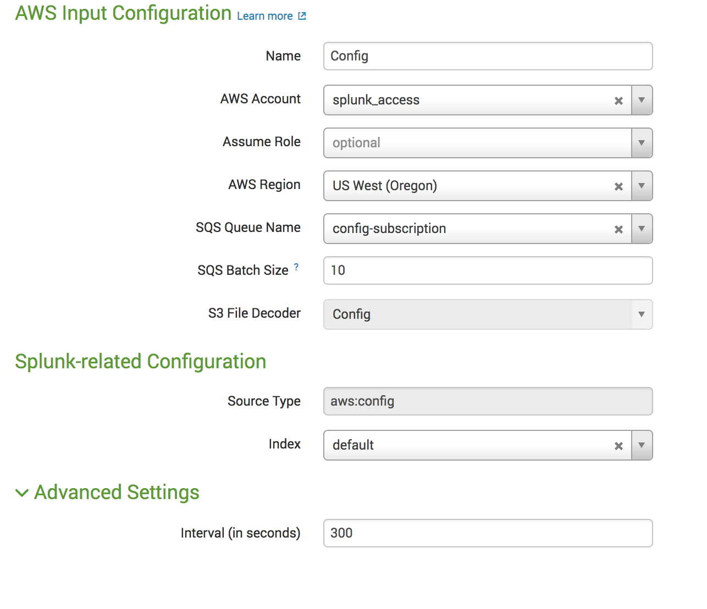
Setup AWS Account / Inputs
AWS Config – SQS Based S3
Select Account and Region
Select SQS
Index – default
Sourcetype – aws:config
Notes:
Setting up AWS Config in Splunk
In the Splunk Add-on for AWS, click on Inputs and click on the “Create New Input” Button. In the dropdown menu, select Config->SQS Based S3:
Under the Settings, name the input Config, select the region you are operating in and the select the AWS Config Queue (config-subscription):
Leave all the default settings and click Save.

Slide 19
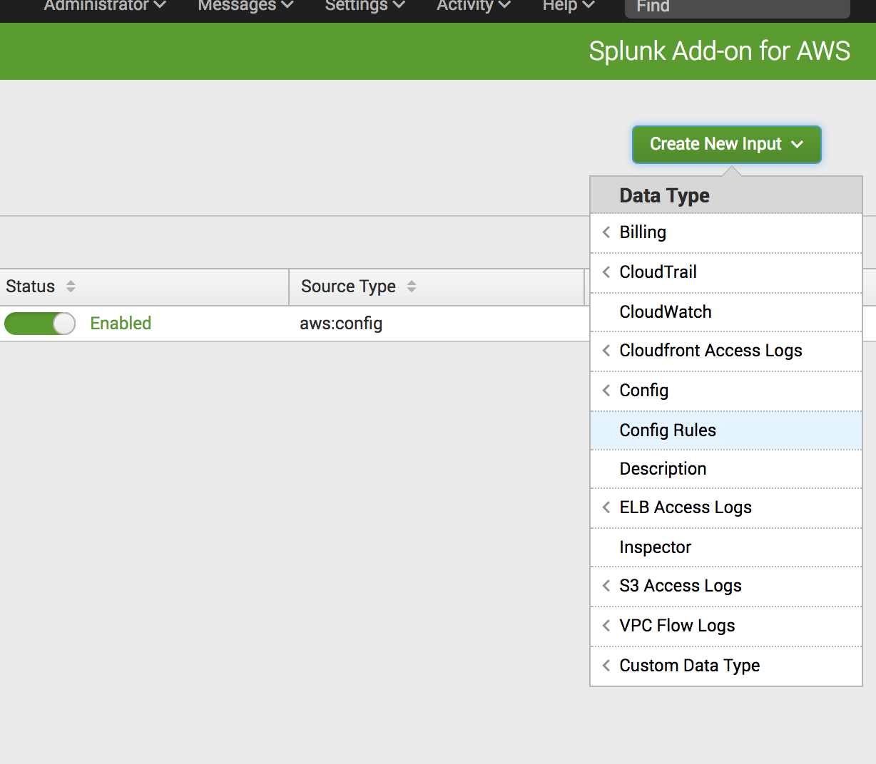
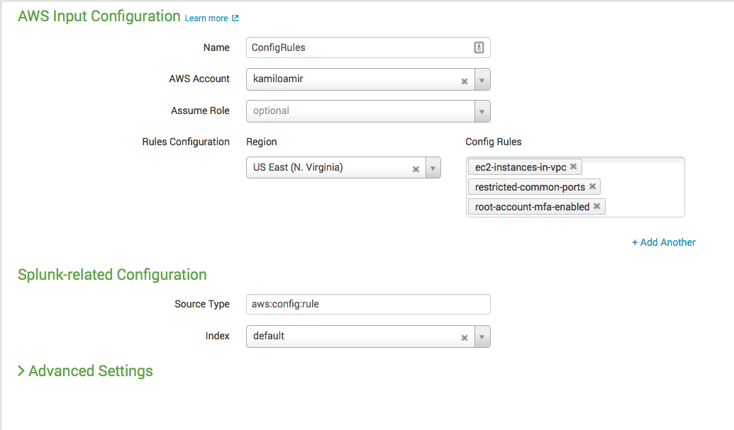
Setup AWS Account / Inputs
AWS Config Rules
Select Account and Region
Select Rules
Index – default
Sourcetype – aws:config:rules
Notes:
Setting up AWS Config Rules in Splunk
In the Splunk Add-on for AWS, click on Inputs and click on the “Create New Input” Button. In the dropdown menu, select Config Rules:
Select the AWS Account, then select the region you are using for your Cloud deployment:
Select the rules you want collected in Splunk then click “Save.”

Slide 20
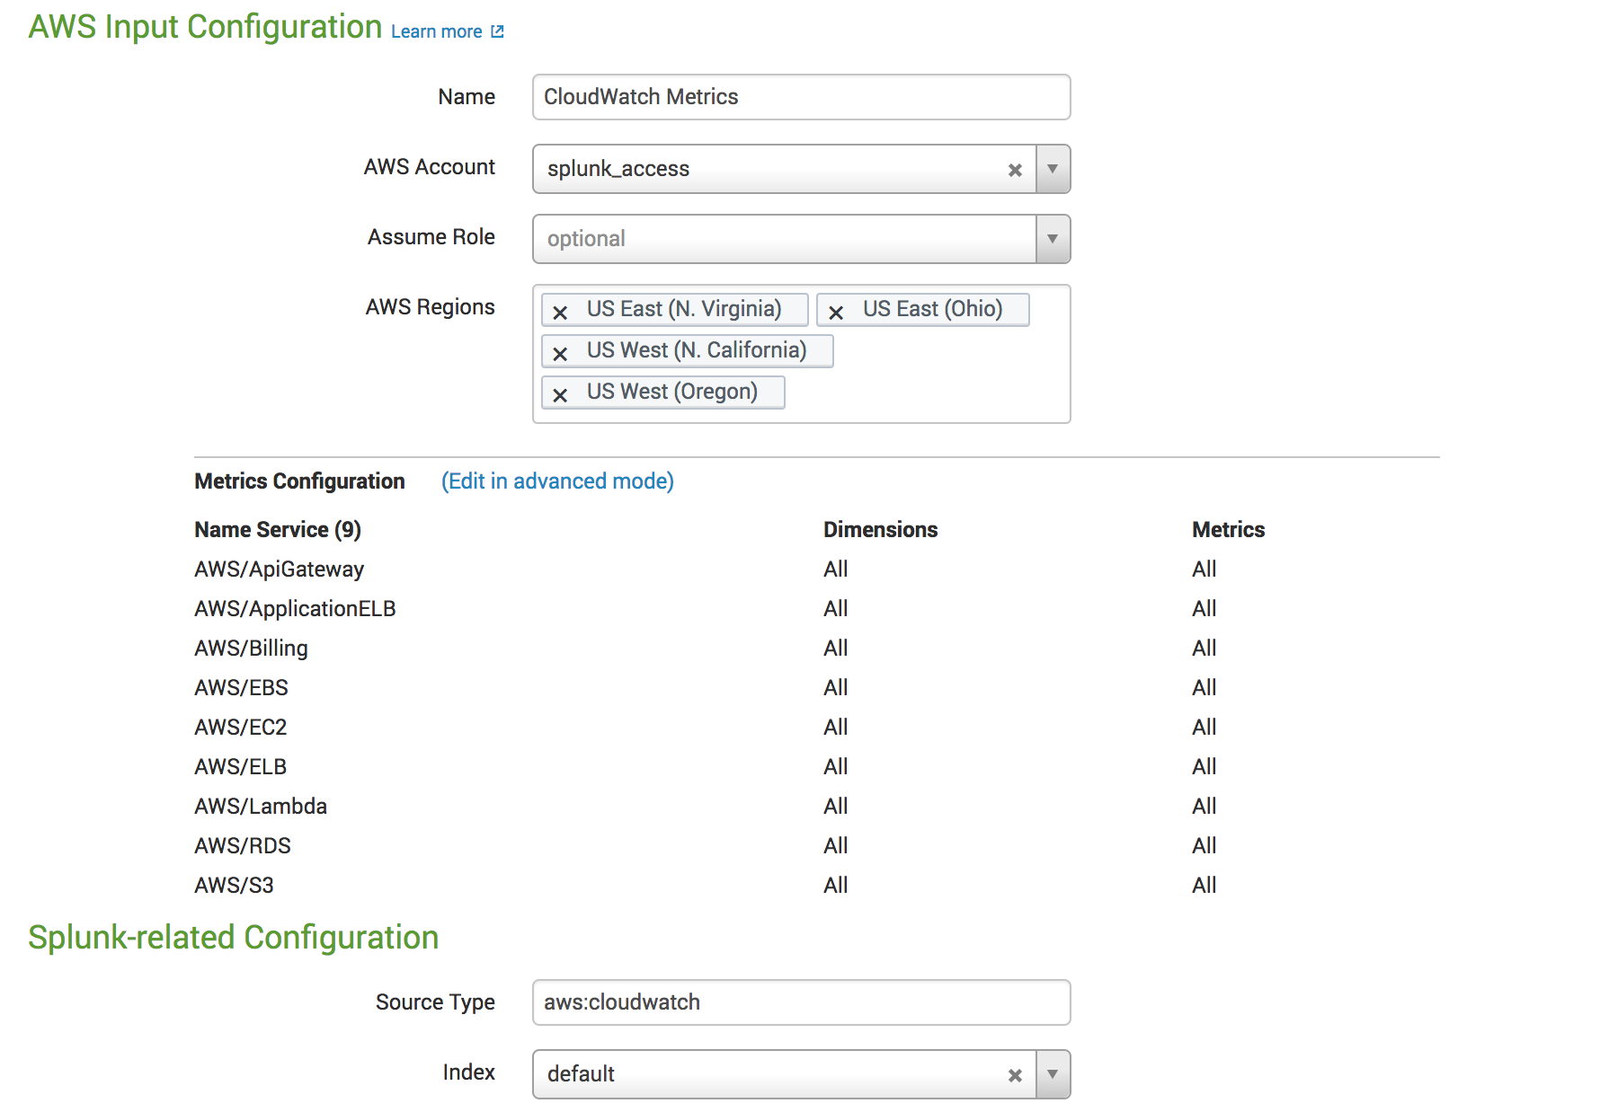
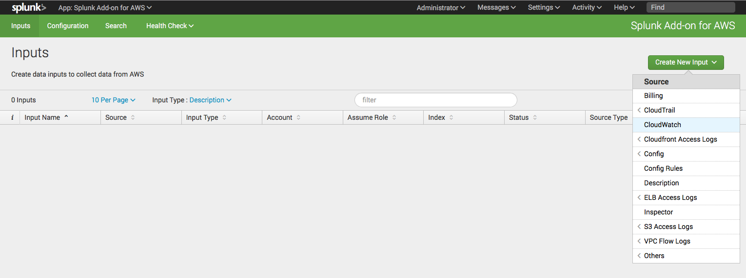
Setup AWS Account / Inputs
AWS CloudWatch (metrics)
Select Regions
Select Services / Metrics
index - default sourcetype - aws:cloudwatch
Notes:
Setting up AWS CloudWatch (metrics) in Splunk
In the Splunk Add-on for AWS, click on Inputs and click on the “Create New Input” Button. In the dropdown menu, select CloudWatch:
Give the input a name, CloudWatch and then select the AWS Account and finally select all the Regions you want to collect data from:
This will collect many services by default, but if you want to add more simply click the “Edit in advanced mode” and add the other services. Leave all the other settings as default and click “Save.”

Slide 21
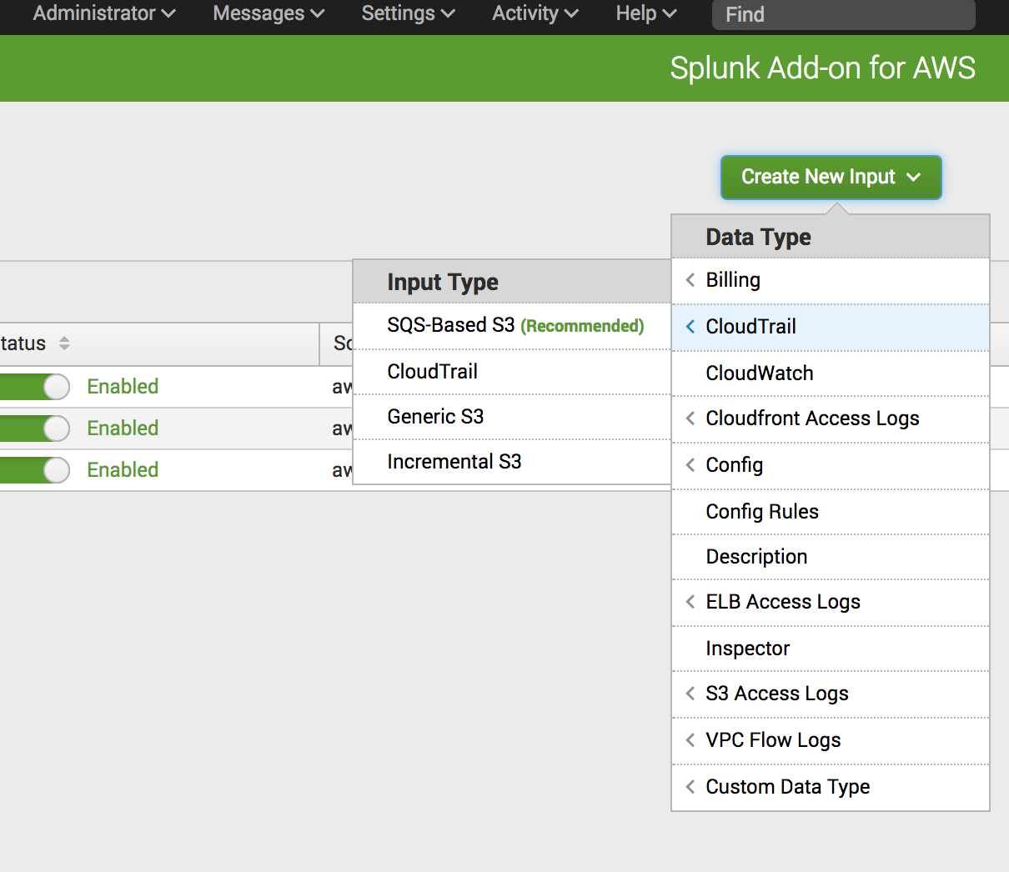
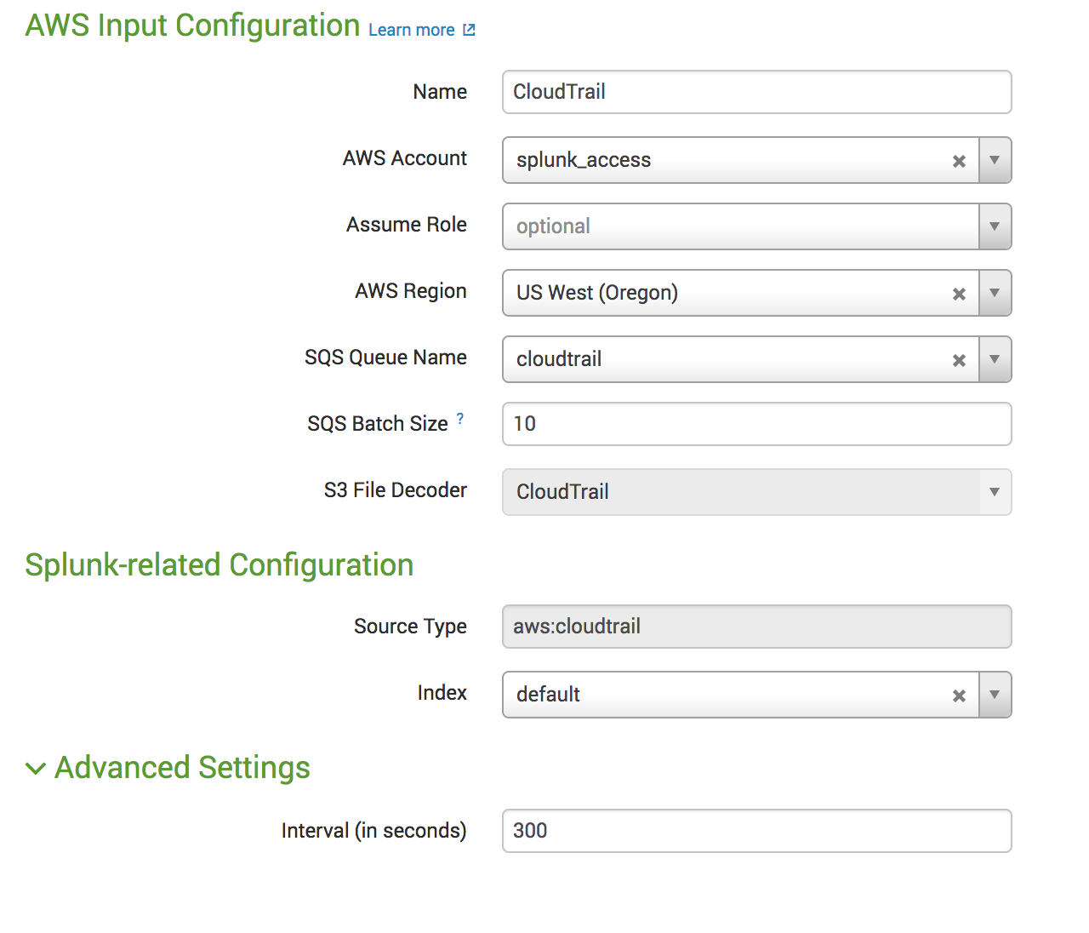
Setup AWS Account / Inputs
AWS CloudTrail – SQS Based S3
Index - default
Sourcetype - aws:cloudtrail
Select SQS
Select Account and Region
Notes:
Setting up AWS CloudTrail in Splunk
In the Splunk Add-on for AWS, click on Inputs and click on the “Create New Input” Button. In the dropdown menu, select CloudTrail->SQS Based S3
Name the input Cloudtrail, then select the AWS account, your default region and the cloudtrail SQS:
Leave all the defaults and click “Submit.”

Slide 22
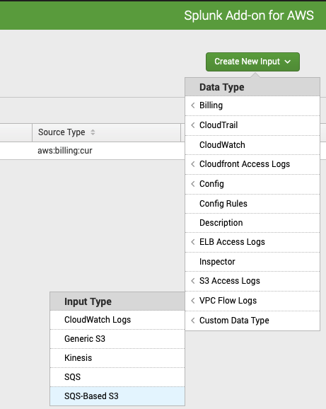
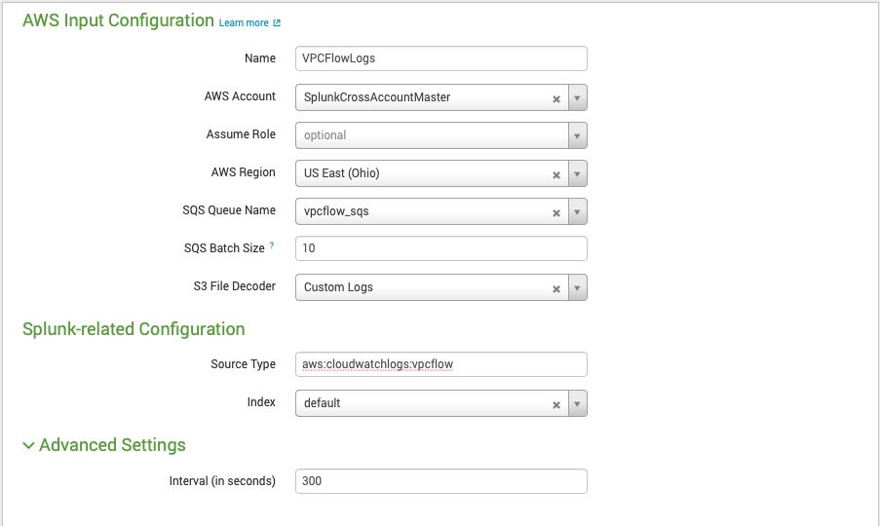
Setup AWS Account / Inputs
AWS VPCFlow – SQS Based S3
Index - default
Sourcetype - aws:cloudwatchlogs:vpcflow
Select SQS
Select Account and Region
Notes:
Setting up AWS CloudTrail in Splunk
In the Splunk Add-on for AWS, click on Inputs and click on the “Create New Input” Button. In the dropdown menu, select CloudTrail->SQS Based S3
Name the input Cloudtrail, then select the AWS account, your default region and the cloudtrail SQS:
Leave all the defaults and click “Submit.”

Slide 23
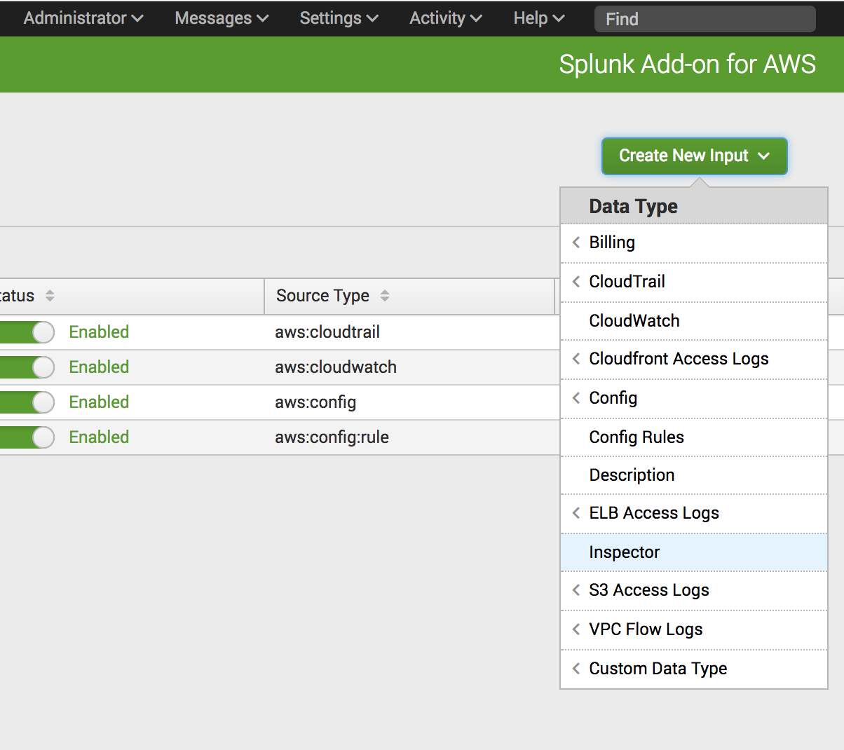
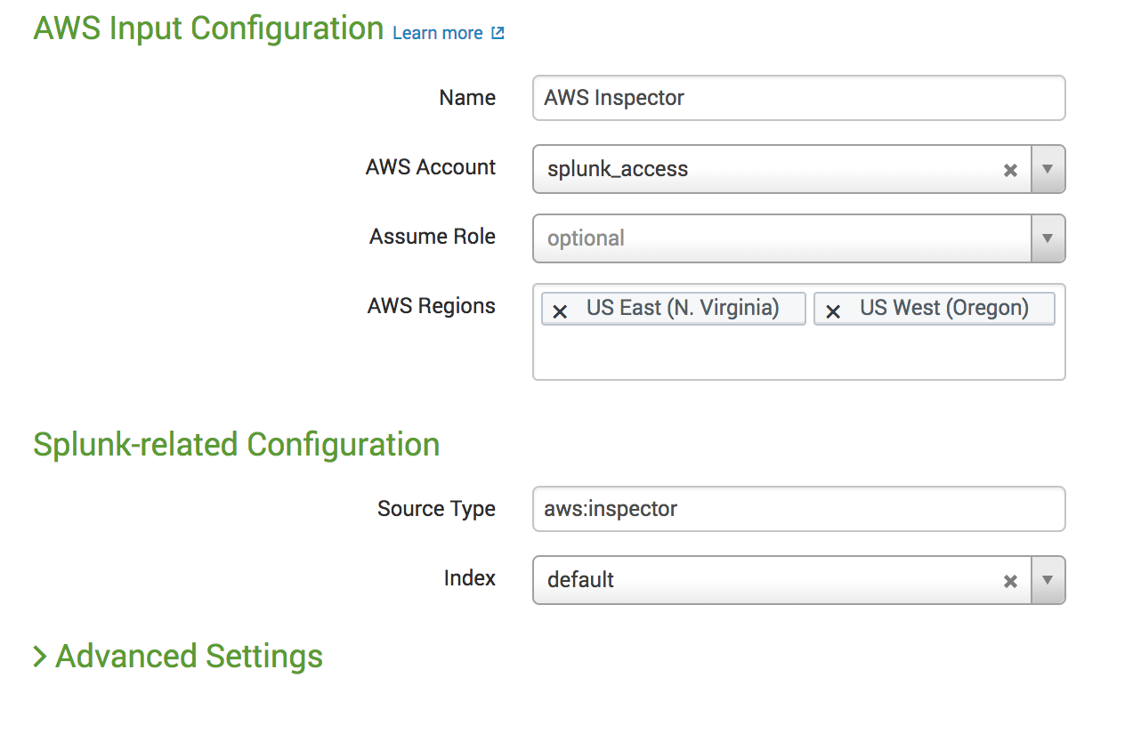
Setup AWS Account / Inputs
AWS Inspector
Select Account and Region
Index – default
Sourcetype – aws:inspector
Notes:
Setting up AWS Inspector in Splunk
In the Splunk Add-on for AWS, click on Inputs and click on the “Create New Input” Button. In the dropdown menu, select Inspector:
Name the input Inspector, then select the AWS account and the regions you want to collect from:
Leave all the defaults and click “Save.”

Slide 24
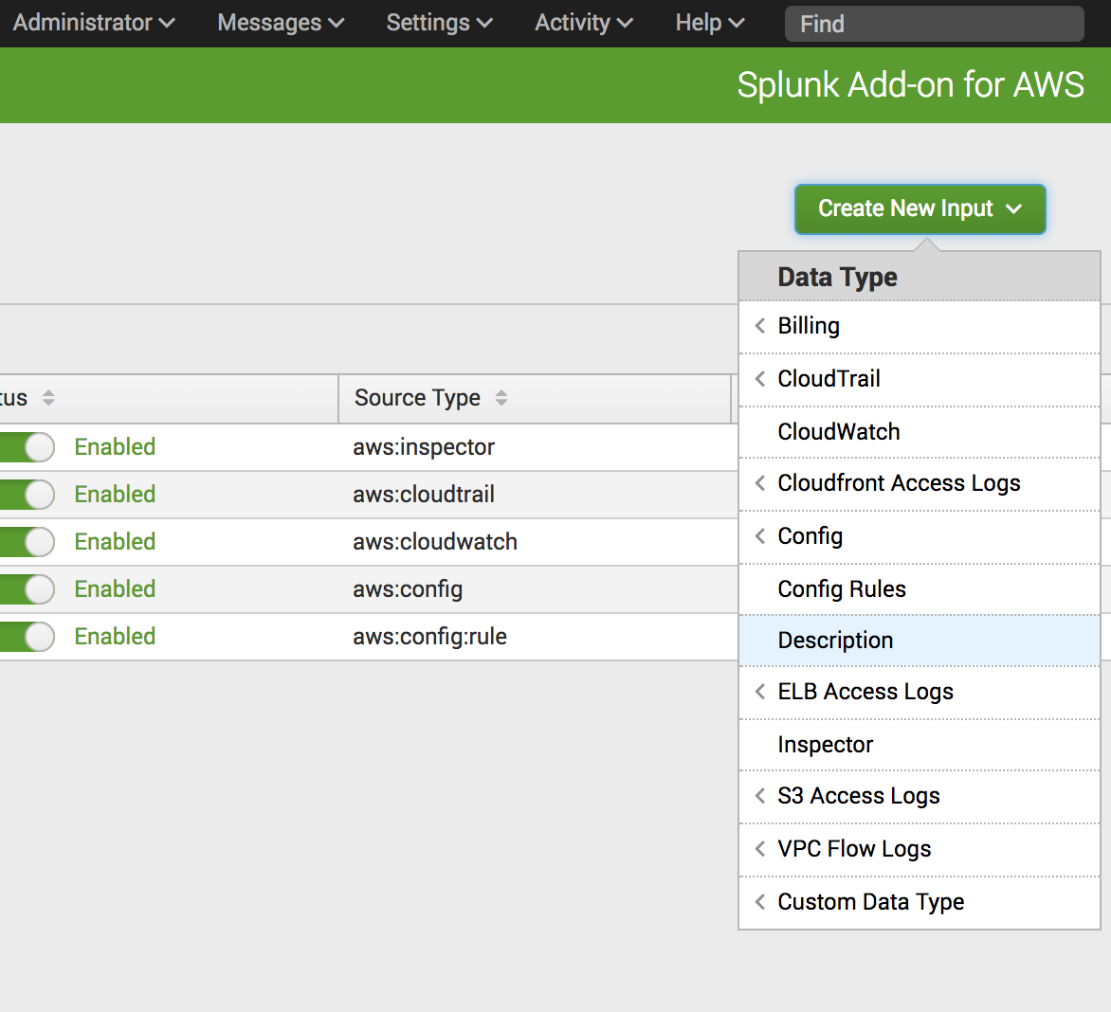
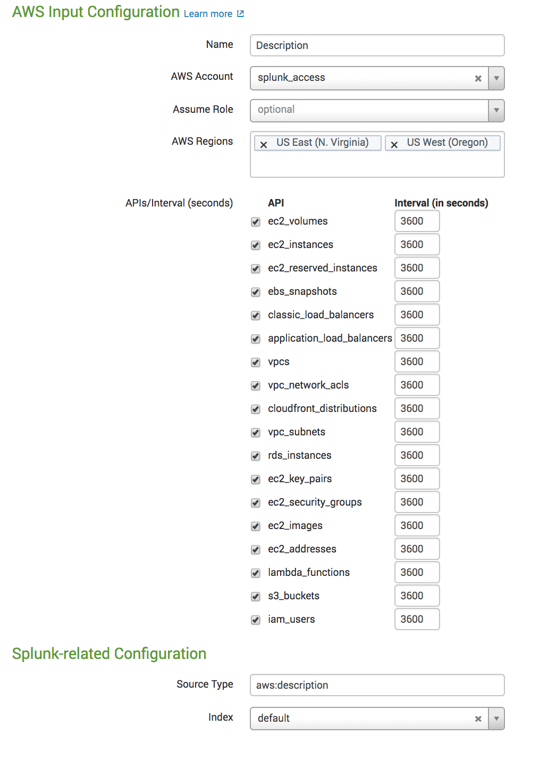
Setup AWS Account / Inputs
AWS Description
Select Account and Region
Index – default
Sourcetype –aws:description
Description API Intervals
Notes:
Setting up AWS Description (metadata) in Splunk
In the Splunk Add-on for AWS, click on Inputs and click on the “Create New Input” Button. In the dropdown menu, select Description:
Name the input Description, select the AWS Account, and then select all the regions you want to collect data from:
Leave all the defaults and click “Save.”

Slide 25
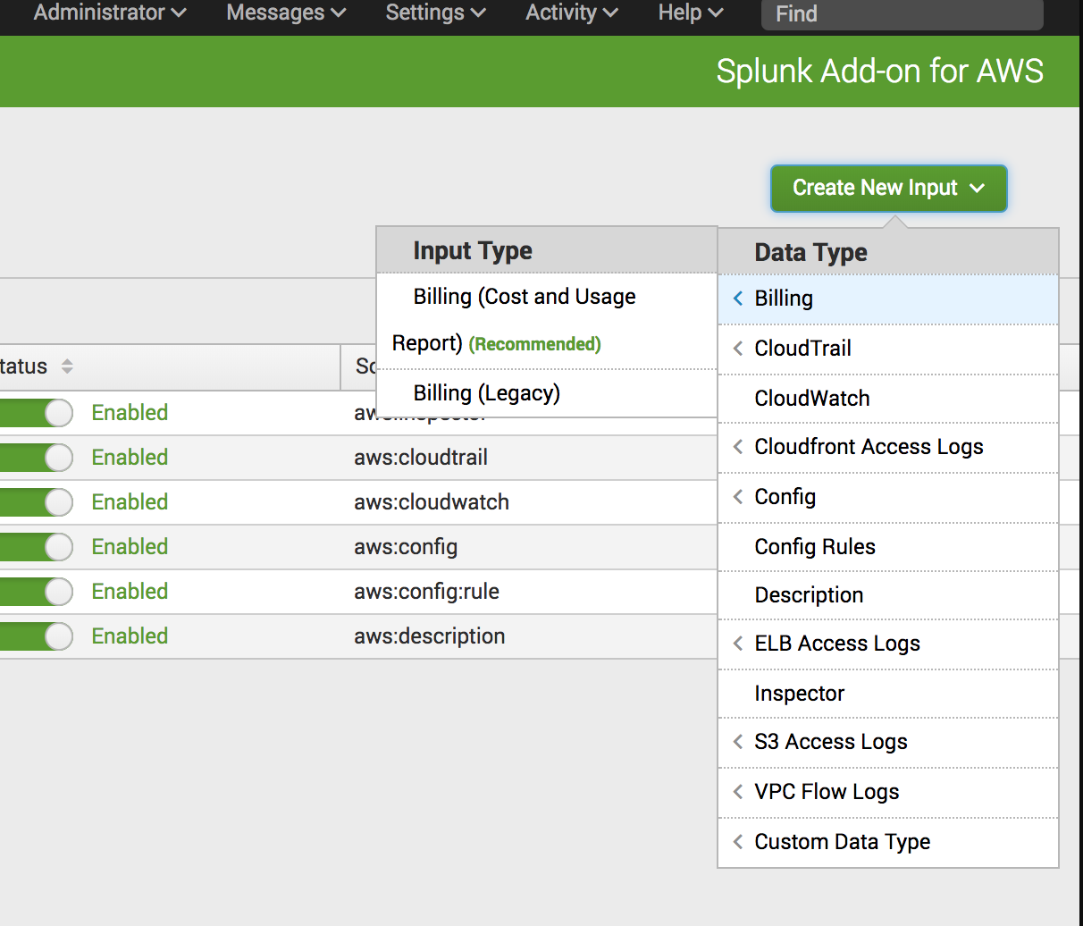
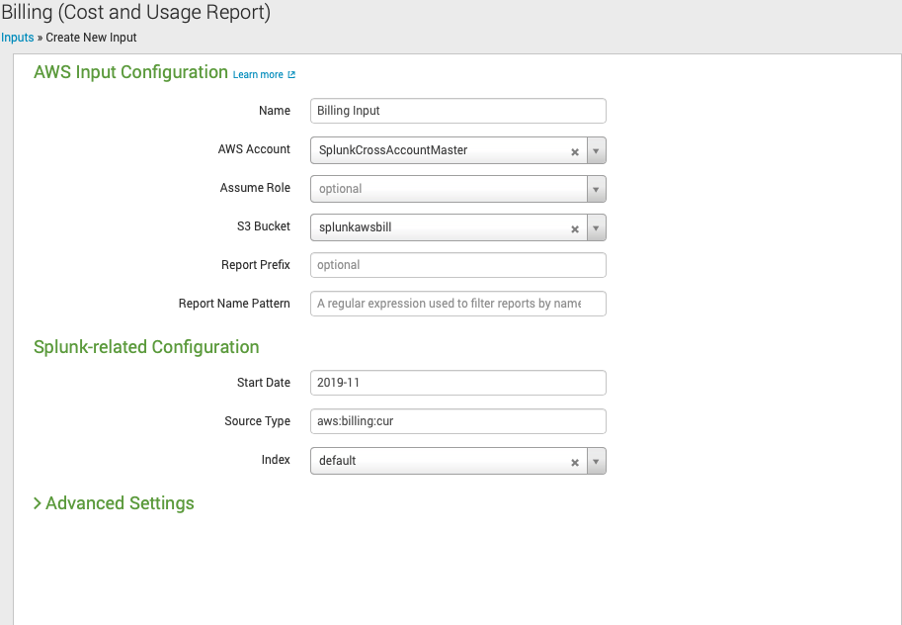
Billing Cost and Usage Report (CUR) 1 of 3
Setup Billing CUR Input
Select Account and S3 Bucket
Index – default
Sourcetype – aws:billing:cur
Billing Report Selection
Notes:
Setting up AWS Billing in Splunk
In the Splunk Add-on for AWS, click on Inputs and click on the “Create New Input” Button. In the dropdown menu, select Billing:
Name the input Billing, select the AWS Account, the Billing S3 bucket, then leave all the default settings.
** Note, if you have a Splunk owned account, you will NOT be able to add this input. **
Leave all the defaults and click “Save.”

Slide 26
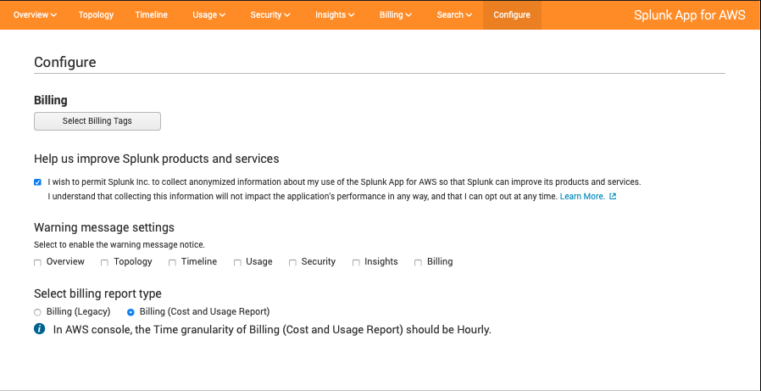
Billing Cost and Usage Report (CUR) 2 of 3
Navigate to Configure
Select CUR
Notes:
Setting up AWS Billing in Splunk
In the Splunk Add-on for AWS, click on Inputs and click on the “Create New Input” Button. In the dropdown menu, select Billing:
Name the input Billing, select the AWS Account, the Billing S3 bucket, then leave all the default settings.
** Note, if you have a Splunk owned account, you will NOT be able to add this input. **
Leave all the defaults and click “Save.”

Slide 27
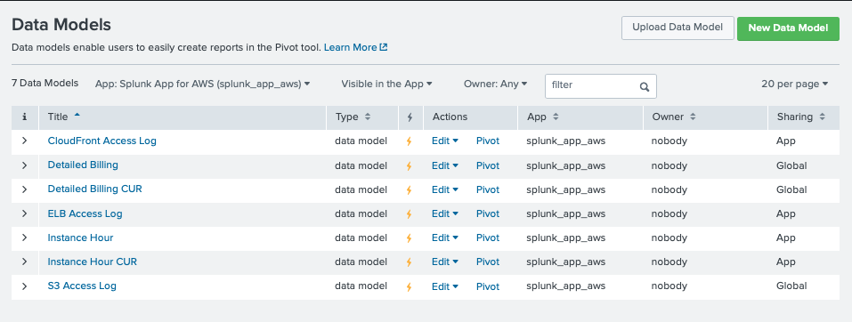
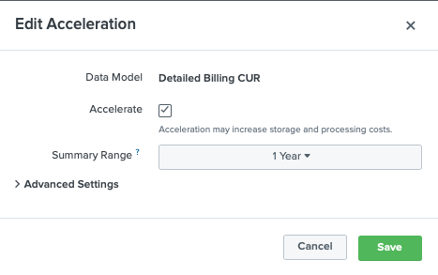
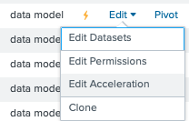
Billing Cost and Usage Report (CUR) 3 of 3
Update Data Models change to at least a year range
Notes:
Setting up AWS Billing in Splunk
In the Splunk Add-on for AWS, click on Inputs and click on the “Create New Input” Button. In the dropdown menu, select Billing:
Name the input Billing, select the AWS Account, the Billing S3 bucket, then leave all the default settings.
** Note, if you have a Splunk owned account, you will NOT be able to add this input. **
Leave all the defaults and click “Save.”

Slide 28
SNS Alerting
Send Splunk alerts to an SNS Topic

Slide 29
Requirements
You will need these in order for the SNS alert workflow to operate
Make sure the AWS TA is installed on your search head
Setup the credentials with a user that has access to write to SNS Topic
Get SNS Topic Name and AWS Region it is located

Slide 30
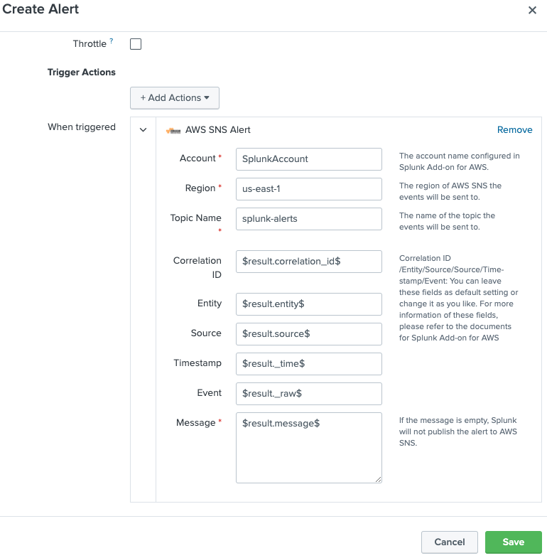
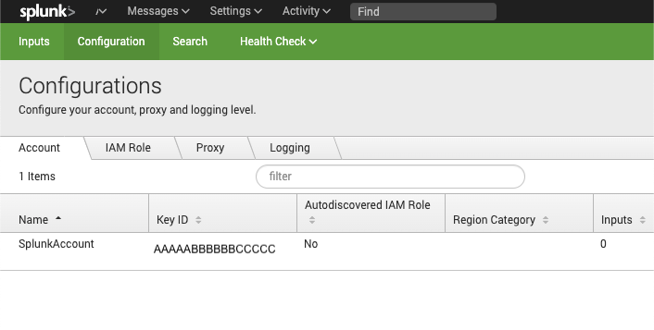
Create SNS Alert
Two Steps
Add Splunk Account from AWS
Create Alert with SNS Alert enabled
From AWS, get your topic name and region

Slide 31
Higher Volume Data Collection
When collecting higher volume data, like VPCFlow Logs, ELB, Access Logs using the HEC with a Lambda function would be recommended.

Slide 32
CloudWatch Logs Input
Lambda function OR Kinesis Data Firehose to HEC
Collect data from HEC via the Lambda Function
HEC Token created in Module 3, Slides 12-20
https://www.splunk.com/blog/2017/02/03/how-to-easily-stream-aws-cloudwatch-logs-to-splunk.html
Collect high volume data sources such as Kinesis or VPC Flow Logs without using a Splunk Heavy Weight Forwarder
For a solution with data resilience, AWS Kinesis Firehose and Splunk TA for Firehose should be considered.
Notes:
In order to collect high volume data, such as VPC Flow Logs, you might want to leverage an AWS Lambda function to send data into Splunk via the HTTP Event Collector (HEC). AWS Lambda functions for this specific use case have been created in the “Blue Print’ section. For a more reliant solution, the Kinesis Firehose should be leveraged instead of a Lambda function. For more information on the Kinesis Firehose, please refer to Module 9 – Setting up Kinesis Firehose.

Slide 33
Logs from S3 bucket
Collecting high volume data from S3 buckets using SQS Based S3 (e.g. VPCFlow logs etc.)

Slide 34
Overview of the process / setup
SQS Setup
Setup S3 bucket
Configure VPC Flow
Setup VPC to S3 connection
Setup SQS Permissions
Enable S3 Event trigger to SQS
Setup Splunk SQS Based S3

Slide 35
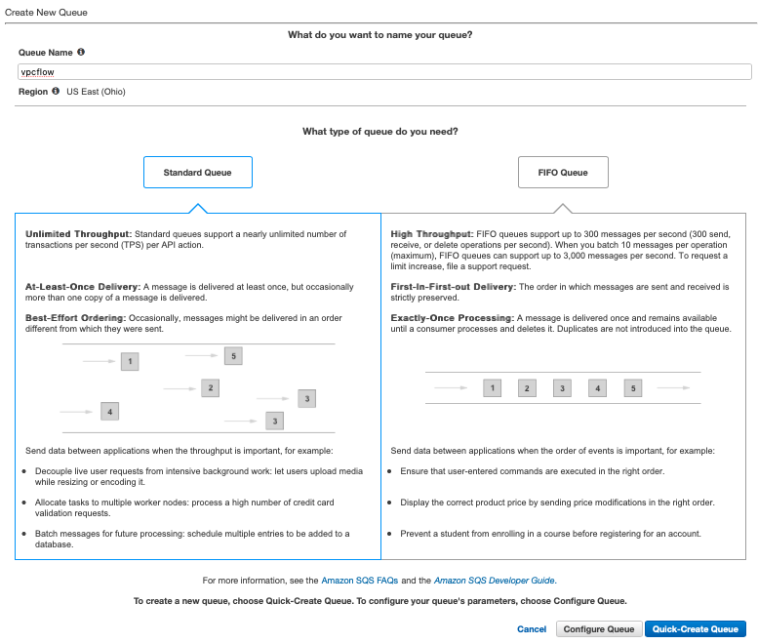
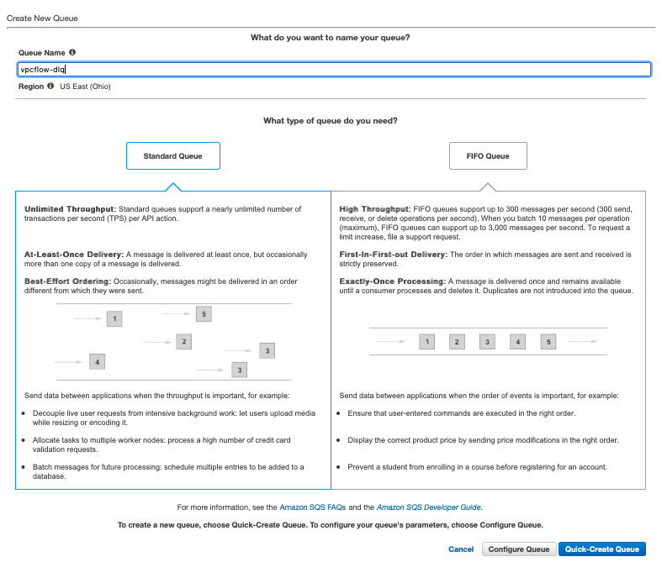
Setup the SQS
Setup ‘vpcflow’ SQS
Setup ‘vpcflow-dlq’ SQS

Slide 36
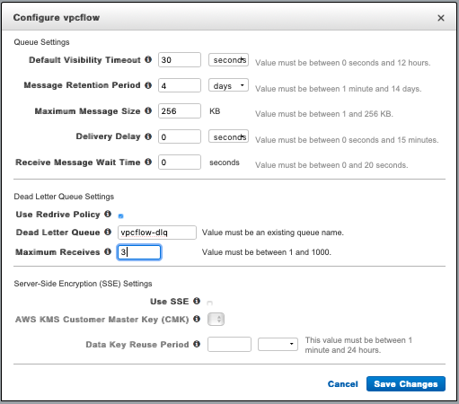
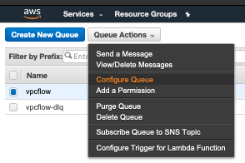
Configure the SQS Dead Letter Queue
Configure ‘vpcflow’ queue
Set vpcflow to use vpcflow-dlq

Slide 37
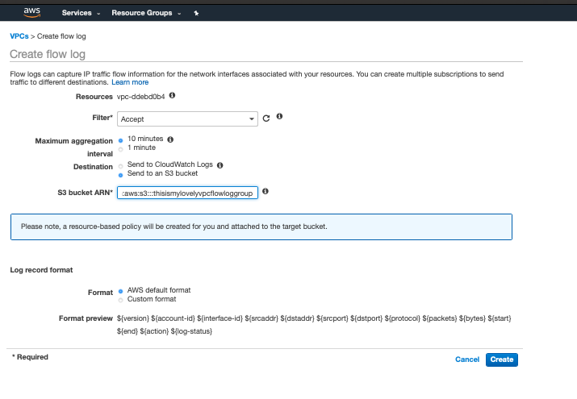
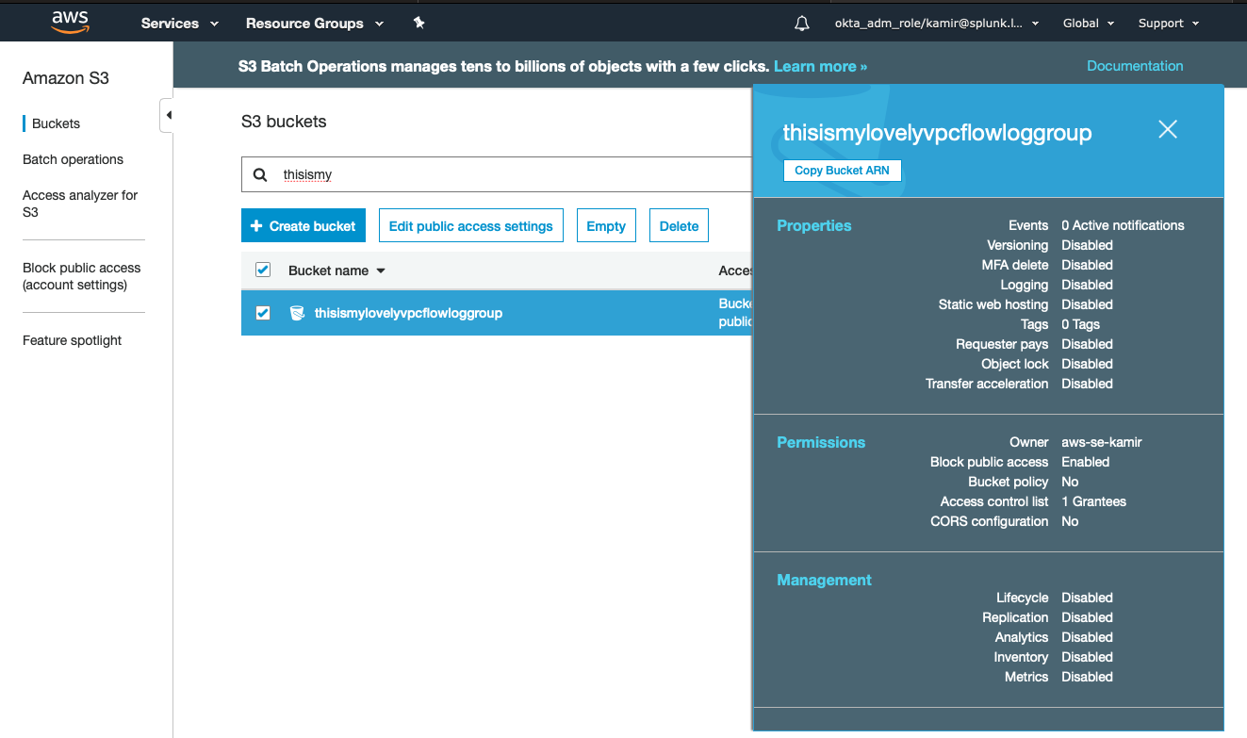
Create S3 bucket and setup VPC flow logs
Create S3 bucket, copy S3 ARN
Create VPC Flow Logs and point to S3 bucket
S3 View
VPC - > Default VPC -> Flow Logs Tab -> Create Flow logs

Slide 38
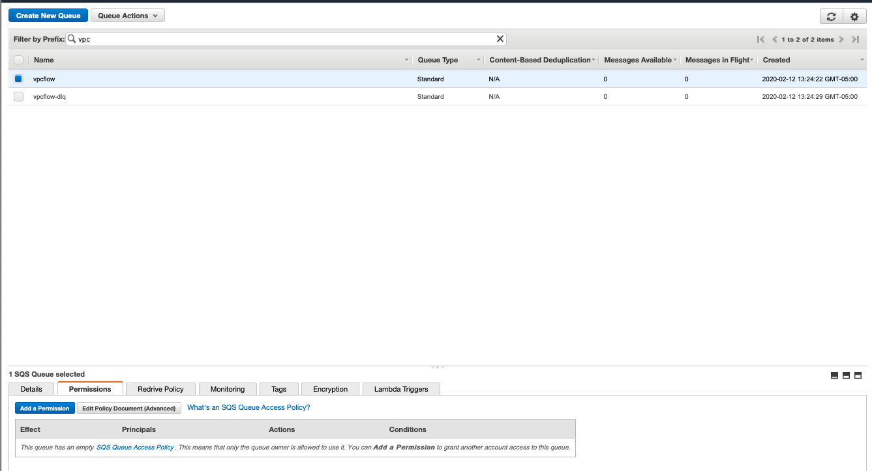
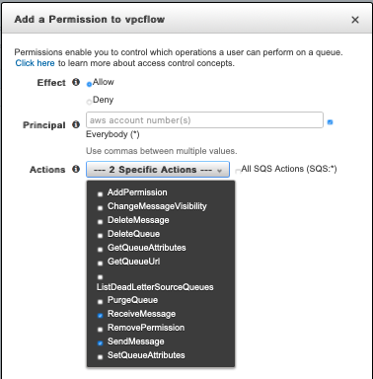
Edit the SQS Permissions (1 of 3)
Select ‘vpcflow’ SQS and click permissions tab
Add the permissions
RecieveMessage
SendMessage

Slide 39
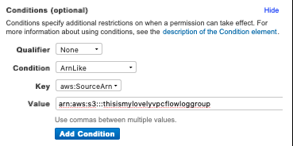
Edit the SQS Permissions (2 of 3)
Click Add Conditions
Permission Policy (sample)
{
"Version": "2012-10-17",
"Id": "arn:aws:sqs:us-east-2:AWS_ACCOUNT_ID:vpcflow/SQSDefaultPolicy",
"Statement": [
{
"Sid": "Sid1581529579877",
"Effect": "Allow",
"Principal": "*",
"Action": [
"SQS:SendMessage",
"SQS:ReceiveMessage"
],
"Resource": "arn:aws:sqs:us-east-2:AWS_ACCOUNT_ID:vpcflow",
"Condition": {
"ArnLike": {
"aws:SourceArn": "arn:aws:s3:::S3_BUCKET"
}
}
}
]
}

Slide 40
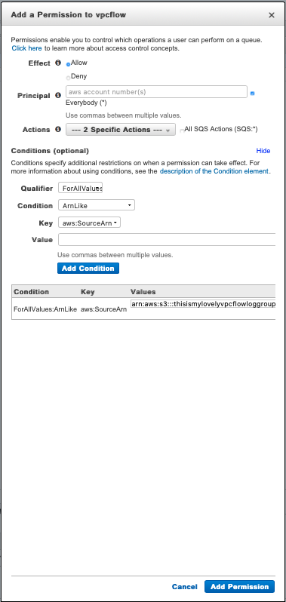
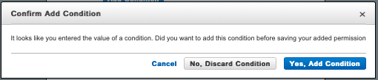
Edit the SQS Permissions (3 of 3)
Click Add Permission
Click, Yes Add Conditions

Slide 41
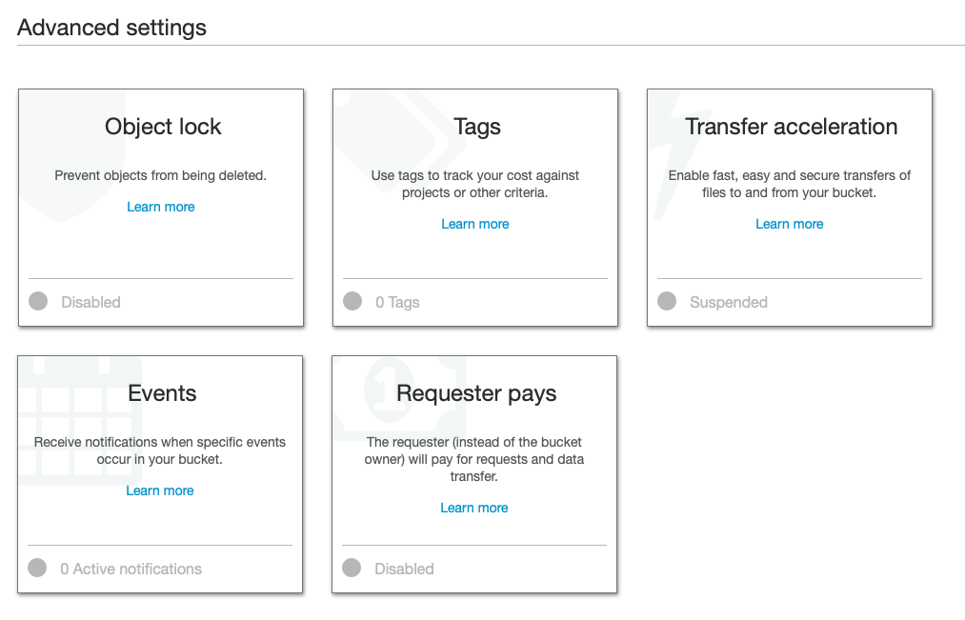
Enable S3 Events
Click on S3 bucket, click on Properties
Enable Events

Slide 42
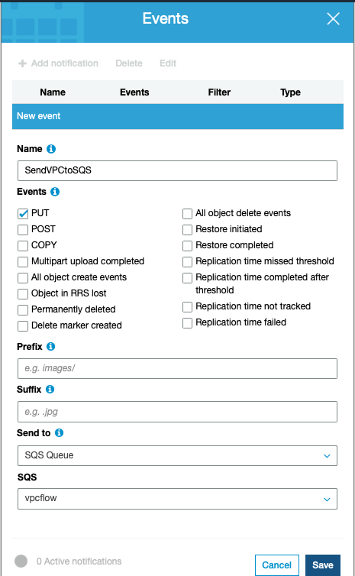
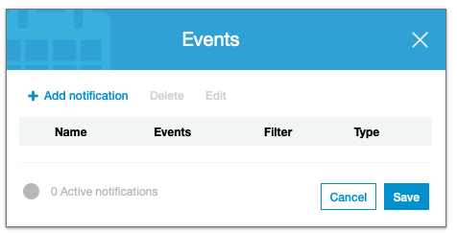
Add SQS Notifications
Add notification
Enter variables
Name the event
Check PUT
Select SQS Queue
Select the vpcflow SQS

Slide 43
Continue to Module 5:
Troubleshooting the Splunk App / Add-on for AWS

